Slide 1
CSC 362: Systems Programming
Programming Environment Setup
Original slides by: Amitabha Dey
Adapted by: Dr. Richard Johnson
Department of Computer Science
University of North Carolina at Greensboro

Slide 2


C/C++ for Systems Programming
Low-Level Memory Management: C/C++ provides direct access to memory and hardware, enabling developers to write efficient system-level code, such as operating systems and drivers.
System-Level Features: C/C++ includes features such as pointers, manual memory allocation (e.g., malloc and free), and bitwise operations, which are essential for understanding system programming concepts like memory management, file systems, and threading.
Wide Industry Adoption: C/C++ is the backbone of many operating systems (e.g., Linux, Windows) and embedded systems, providing practical insights into real-world systems.
Compatibility with System Calls: C provides seamless integration with low-level system calls and kernel interfaces, enabling direct interaction with operating system features.
Dennis Ritchie, Creator of C
Bjarne Stroustrup, Creator of C++
Notes:
C/C++ for Systems Programming
Low-Level Memory Management: C/C++ allows direct access to memory and hardware, which is critical for writing operating systems and drivers.
System Features: Key features include pointers, manual memory allocation (e.g., malloc and free), and bitwise operations.
Industry Adoption: These languages form the backbone of major operating systems like Linux and Windows.
System Calls: C integrates seamlessly with low-level kernel interfaces.
Founders of C and C++: Dennis Ritchie (Creator of C) and Bjarne Stroustrup (Creator of C++).

Slide 3
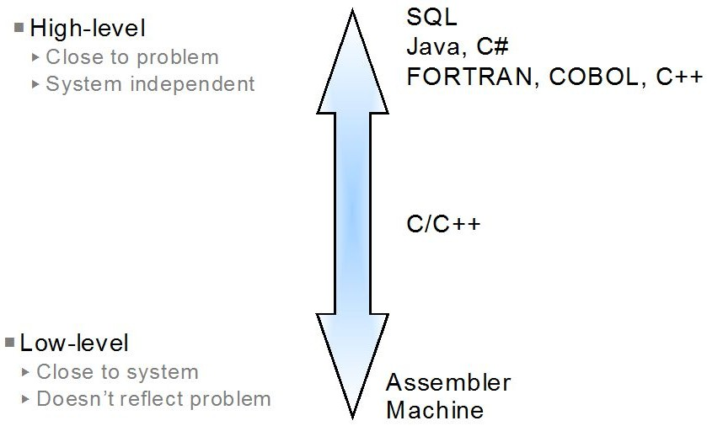
C/C++ for Systems Programming (cont.)
In a high-level language, programmers don’t have to be concerned with low-level details like memory management or hardware specific instructions.
Low-level languages are closer to machine code and provide less abstraction.
High-level languages provide a higher level of abstraction and are more user-friendly, while low-level languages offer more control over hardware but at the cost of increased complexity and reduced productivity.
Image credit - https://icarus.cs.weber.edu/
Notes:
Language Abstraction
High-Level Languages: Hide low-level details like memory management to increase user-friendliness and productivity.
Low-Level Languages: Closer to machine code, providing more hardware control at the cost of increased complexity.

Slide 4
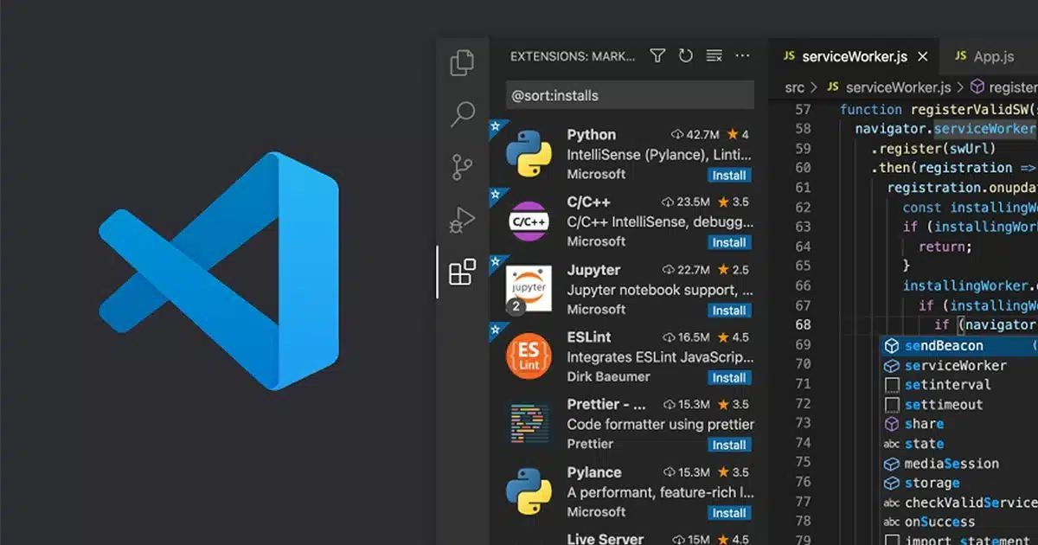
Setting up your programming environment (IDE)
Integrated Development Environment (IDE)
For CSC362,
we will use Microsoft Visual Studio Code
Visual Studios Installation Tutorials:
Windows
Mac
Linux
Notes:
IDE and Extensions
The course uses Microsoft Visual Studio Code as the primary IDE.
Installation tutorials are available for Windows, Mac, and Linux .

Slide 5
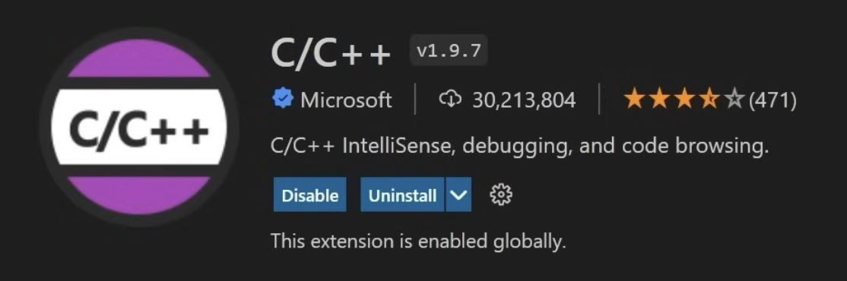
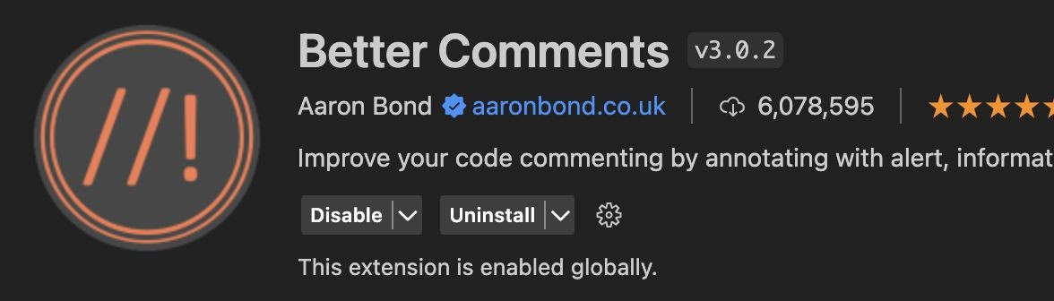
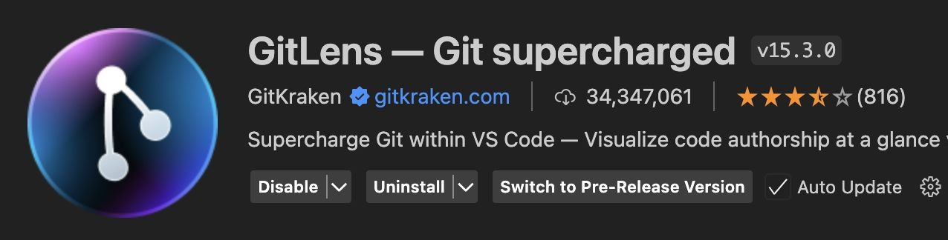
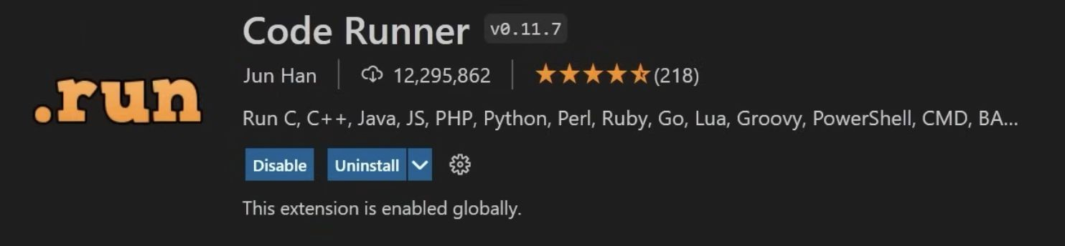
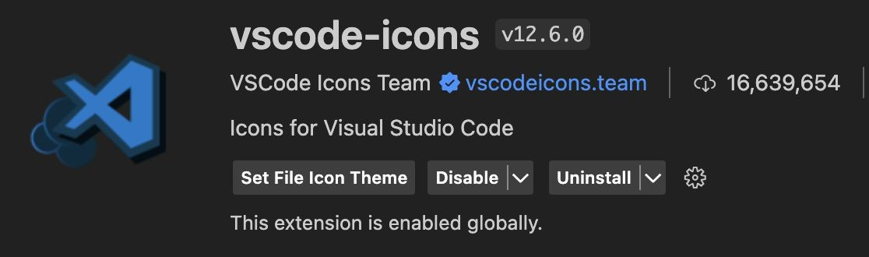
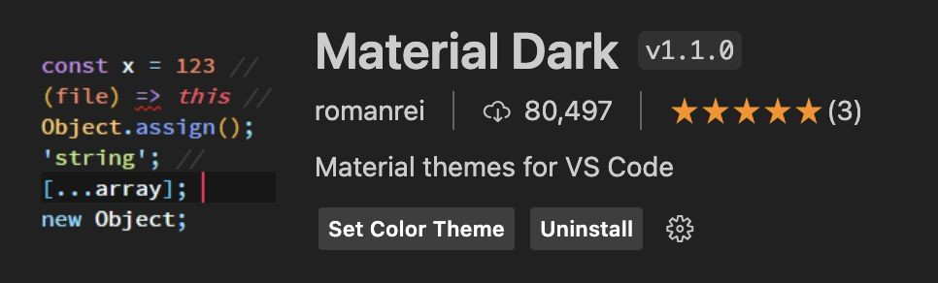

Setting up your programming environment (Extensions)
Integrated Development Environment (IDE)
Useful extensions for VScode:

Slide 6

Setting up your programming environment (OS)
UNIX-like Operating Systems
Why configure UNIX-like Environment?
Gain insight into system-level operations and processes.
Enable interaction with system calls and inspect architecture.
Standardize experience across different operating systems.
Learn and experiment with system-level APIs.
Develop portable code that runs on Linux/UNIX.
Understand how operating systems manage resources.
Linux: Native environment; no additional setup required.
MacOS: UNIX-like OS; supports most commands natively.
Windows: Requires WSL (Windows Subsystem for Linux).
Notes:
Why UNIX-like?:
To gain insight into system-level operations, standardize experience across platforms, and learn system-level APIs
Platform Specifics:
Linux is native; MacOS is UNIX-like; Windows users must install WSL (Windows Subsystem for Linux) .

Slide 7
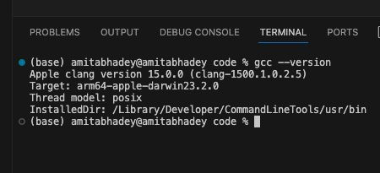
Setting up your programming environment (Compiler Installation)
Compiler (GCC/Clang)
Install the Compiler:
For GCC: You can install GCC on Linux using your distribution's package manager. On Windows, you might use tools like MinGW or install the Windows Subsystem for Linux (WSL) with GCC. On macOS, you can use tools like Homebrew to install GCC.
For Clang: You can install Clang on various platforms, including Linux, macOS, and Windows. On Linux, you can use your distribution's package manager. On macOS, you can use Homebrew or install Xcode Command Line Tools. On Windows, you can use tools like MSYS2 or the LLVM project's official distribution.

Slide 8


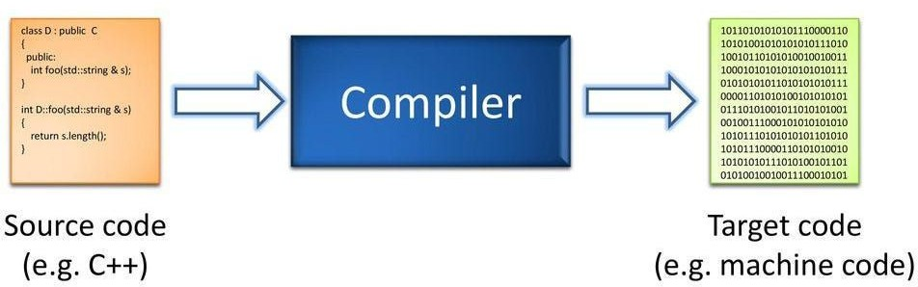
Setting up your programming environment (Compilers)
Compiler (GCC/Clang)
Useful resource:
MinGW Compiler:
Installing MinGW Compiler for VSCode on Win 10 x64
Homebrew:
Download and Install Homebrew
Tutorial for Homebrew setup
Git:
Download Git
Notes:
Compiler Installation
Instructions for installing GCC and Clang across different platforms using package managers like apt (Linux), Homebrew (macOS), or MinGW/WSL (Windows)

Slide 9
Setting up your programming environment (WSL / GCC via terminal)
For Windows Users
Install WSL on Windows
Install GCC
Open PowerShell as Administrator.
Inside WSL, install the GCC compiler if you haven’t already:
Run the following command to install WSL with the default Ubuntu distribution:
sudo apt update sudo apt install gcc -y
wsl --install
Check if it’s installed correctly:
Once the installation completes, restart your computer.
gcc --version
After restarting, open Ubuntu (or another installed Linux distribution) from the Start Menu and set up a username and password.

Slide 10

Setting up your programming environment (WSL / GCC)
For Windows Users
Install WSL Extension
Set WSL as the Default Terminal in VS Code
Install WSL extension in Microsoft VScode
Open VS Code.
Press Ctrl + Shift + P to open the Command Palette.
Search for and select "Preferences: Open User Settings (JSON)".
"terminal.integrated.defaultProfile.windows": "WSL"

Slide 11


Setting up your GitHub
GitHub is a widely-used web service for managing programming projects.
Sign up for a GitHub account, if you don't already have one.
You may have used it in earlier classes, but if not don't worry about it -- the way we will use it in this class is very straightforward, and you only need to know a few things (which we'll discuss in class).
Notes:
GitHub
GitHub is used for managing projects; students should sign up for an account if they don't have one.

Slide 12
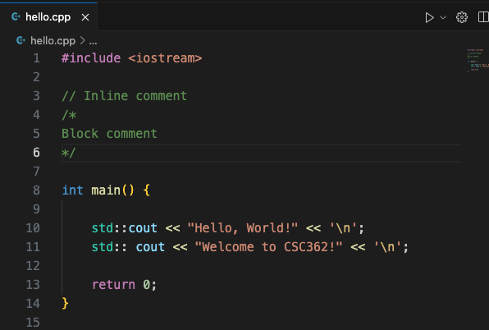
C++ Structure and Syntax
#include <iostream> tells the compiler to include contents of the <iostream> header file. This header file provides functionality for input and output operations. C++ Header files: See the documentation here.
Every C++ program must have a main() function and the execution begins from here.
Standard character output (std::cout) is used to output the string. \n starts a new line
It’s a common convention to put return 0 the end of the main function. If it returns 0, the main function executed successfully. A non-zero value typically indicates an error.
Notes:
C++ Structure and Syntax
Headers: #include <iostream> is used for input/output operations.
The main() Function: Every program must have a main() function where execution begins.
Output: std::cout outputs strings, and \n is used for new lines.
Return Values: Returning 0 signals successful execution, while non-zero values indicate errors.

Slide 13
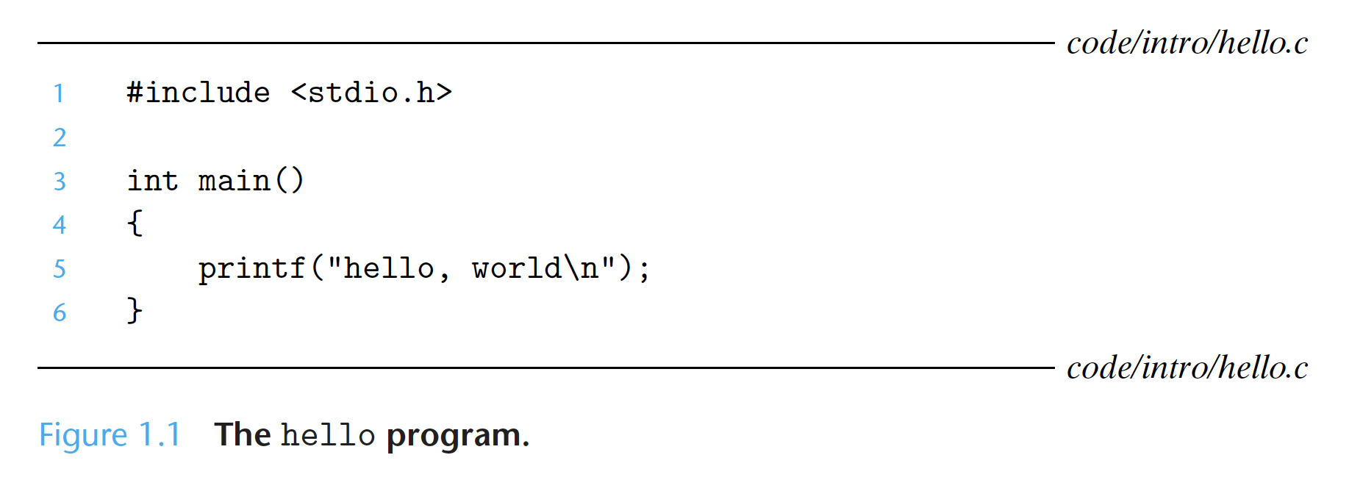
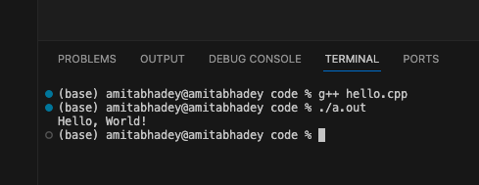
“Hello World” program
Image credit - Computer Systems, Bryant, O’Hallaron
The shell is a command-line interpreter that prints a prompt, waits for you to type a command line, and then performs the command. If the first word of the command line does not correspond to a built-in shell command, then the shell assumes that it is the name of an executable file that it should load and run.

Slide 14
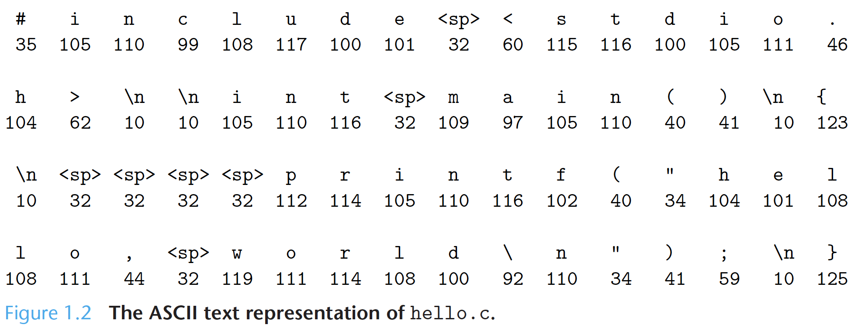
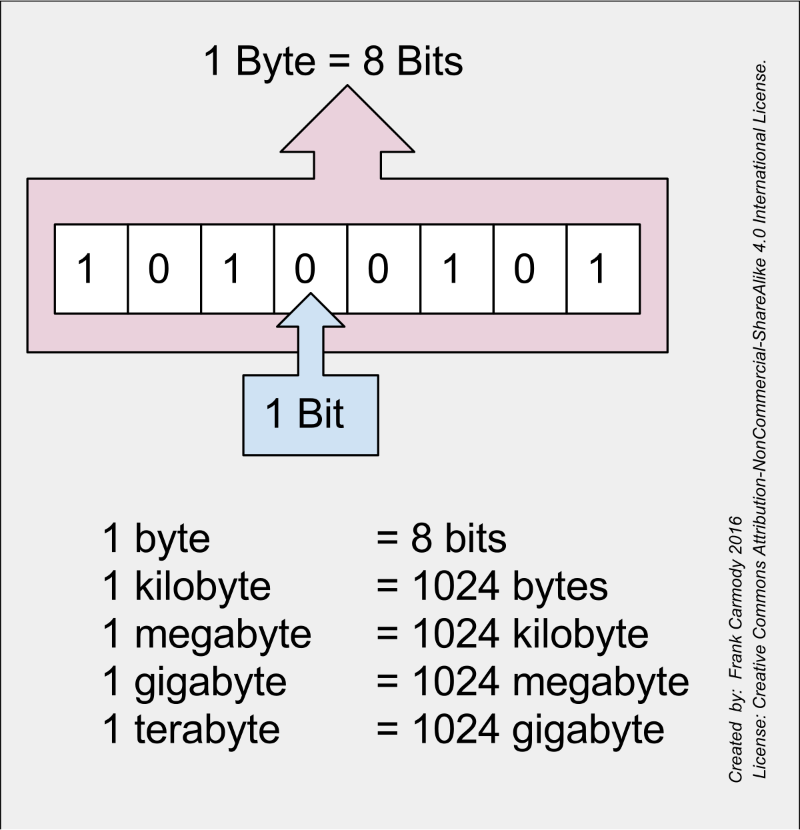
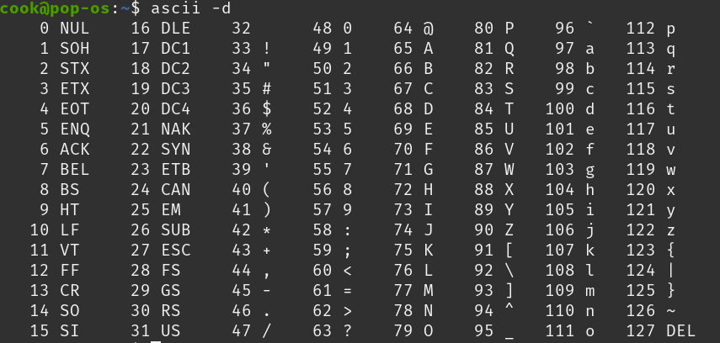

Information is Bits + Context
The hello program starts as a source program (or source file) that the programmer creates with an editor and saves in a text file called hello.c (hello.cpp in C++).
The source program is a sequence of bits, each with a value of 0 or 1, organized in 8-bit chunks called bytes.
Each byte represents some text character in the program.
The hello.c program is stored in a file as a sequence of bytes. Each byte has an integer value that corresponds to some character.
Image credit - Computer Systems, Bryant, O’Hallaron
Image credit - ASCII & UNICODE @ Medium
Notes:
Information and Bits
Storage: Programs (like hello.cpp) are stored as sequences of bits (0s and 1s) organized into 8-bit bytes representing text characters.
Context: The only difference between data objects (integers, strings, or instructions) is the context in which those bits are viewed.

Slide 15
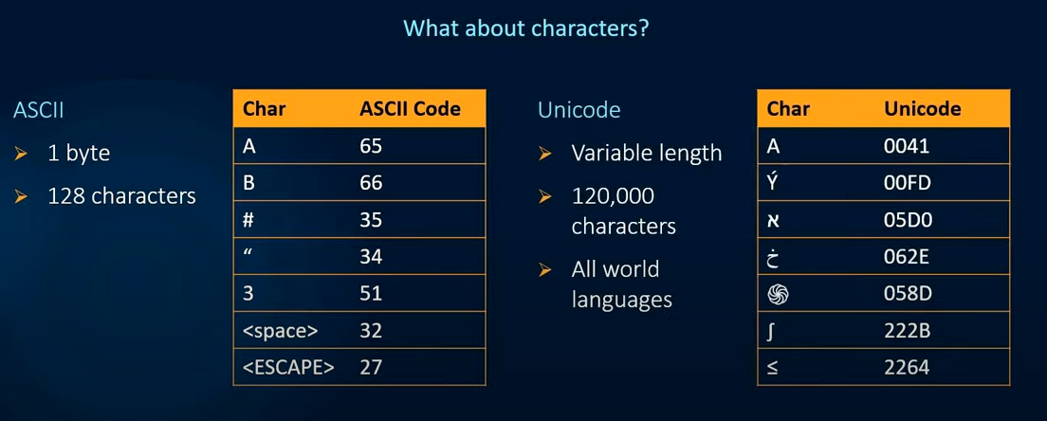
Information is Bits + Context (continued 1)
Notes:
What about characters?
Comparison of ASCII and Unicode.
ASCII is described as 1 byte with 128 characters, shown with a table mapping characters like 'A' to code 65.
Unicode is described as variable length with 120,000 characters covering all world languages, shown with a table mapping various international symbols and mathematical operators to hexadecimal codes.

Slide 16
Information is Bits + Context (continued 2)
All information in a system—including disk files, programs stored in memory, user data stored in memory, and data transferred across a network—is represented as a bunch of bits.
The only thing that distinguishes different data objects is the context in which
we view them. For example, in different contexts, the same sequence of bytes
might represent an integer, floating-point number, character string, or machine instruction.

Slide 17
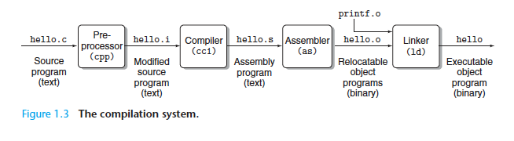
The Compilation System
3. Assembly Phase
Next, the assembler (as) translates hello.s into machine language instructions, packages them in a form known as a relocatable object program and stores the result in the object file hello.o. The hello.o file is a binary file whose bytes encode machine language instructions rather than characters. If we were to view hello.o with a text editor, it would appear to be gibberish.
1. Preprocessing Phase
2. Compilation Phase
The preprocessor (cpp) modifies the original C program according to directives that begin with the # character. For example, the
#include <stdio.h> command in line 1 of hello.c tells the preprocessor to read the contents of the system header file stdio.h and insert it directly into the program text.
The compiler (cc1) translates the text file hello.i into the text file hello.s, which contains an assembly-language program. Each statement in an assembly-language program exactly describes one low-level machine-language instruction in a standard text form. Assembly language is useful because it provides a common output language for different compilers for different high-level languages.
4. Linking Phase
Notice that our hello program calls the printf function, which is part of the standard C library provided by every C compiler. The printf function resides in a separate precompiled object file called printf.o, which must somehow be merged with our hello.o program. The linker (ld) handles this merging. The result is the hello file, which is an executable object file (or simply executable) that is ready to be loaded into memory and executed by the system.
Image credit - Computer Systems, Bryant, O’Hallaron
Notes:
Compilation Workflow
Basic Overview: A linear process diagram showing human-readable "Source code" (e.g., C++) passing through a "Compiler" to become "Target code" (e.g., binary machine code).
Detailed System: A technical flow labeled "The compilation system" shows the four internal stages of translating a file (hello.c):
Preprocessing (cpp): Modifies the source code based on directives starting with # (e.g., inserting header files). Results in modified source (hello.i).
Compilation (cc1): Translates preprocessed code into assembly language, which describes low-level machine instructions. Translates to an assembly program (hello.s).
Assembly (as): Translates assembly into machine language instructions, stored as a binary "relocatable object program" (.o file). Creates a relocatable object program (hello.o).
Linker (ld): Merges separate object files (like your code and standard library functions like printf) into a single executable. Combines object files with system libraries (like printf.o) to create the final executable (hello).

Slide 18

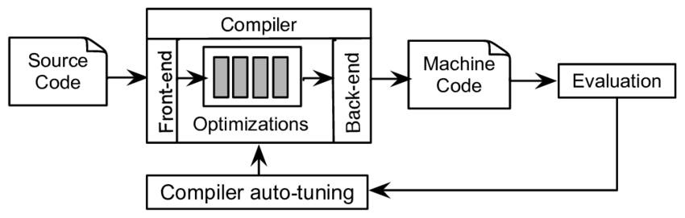
Becoming a Power Programmer
Optimizing Program Performance
Need to understand machine-level code and how compiler translates different C statements into machine code to make good coding decisions.
Is a switch statement always more efficient than a sequence of if-else statements?
How much overhead is incurred by a function call?
Is a while loop more efficient than a for loop?
Are pointer references more efficient than array indexes?
Why does our loop run so much faster if we sum into a local variable instead of an argument that is passed by reference?
How can a function run faster when we simply rearrange the parentheses in an arithmetic expression?
Compiler Optimization
Control Flow
Data Distribution
Code Readability
Function Prologue and Epilogue
Parameter Passing
Return Value Handling
Pointer Arithmetic
Memory Access Patterns
Cache Efficiency
Floating-Point Precision
Compiler Flags and Settings
Lokuciejewski, P., Plazar, S., Falk, H., Marwedel, P., & Thiele, L. (2011). Approximating Pareto optimal compiler optimization sequences—a trade‐off between WCET, ACET and code size. Software: Practice and Experience, 41(12), 1437-1458.
Notes:
Optimization:
Understanding machine code helps in making efficient coding decisions, such as choosing between loops (while vs. for) or data structures (pointers vs. arrays).

Slide 19
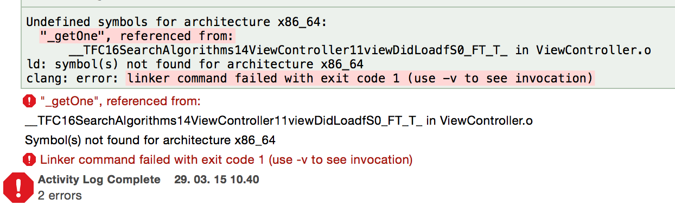
Becoming a Power Programmer (cont.1)
Understanding Link-time Errors
Some of the most perplexing programming errors are related to the operation of the linker, especially when you are trying to build large software systems.
What does it mean when the linker reports that it cannot resolve a reference?
What is the difference between a static variable and a global variable?
What happens if you define two global variables in different C files with the same name?
What is the difference between a static library and a dynamic library?
Why does it matter what order we list libraries on the command line?
Missing Implementation
Misspelled Symbol
Mismatched Signatures
Missing Library or Object File
Namespace Issues
Conditional Compilation
Scope, Lifetime, Initialization, Storage, Access
Symbol Resolution
Circular Dependencies
Notes:
Link-time Errors:
Mastering the linker is essential for resolving references and understanding differences between static and global variables or libraries.

Slide 20
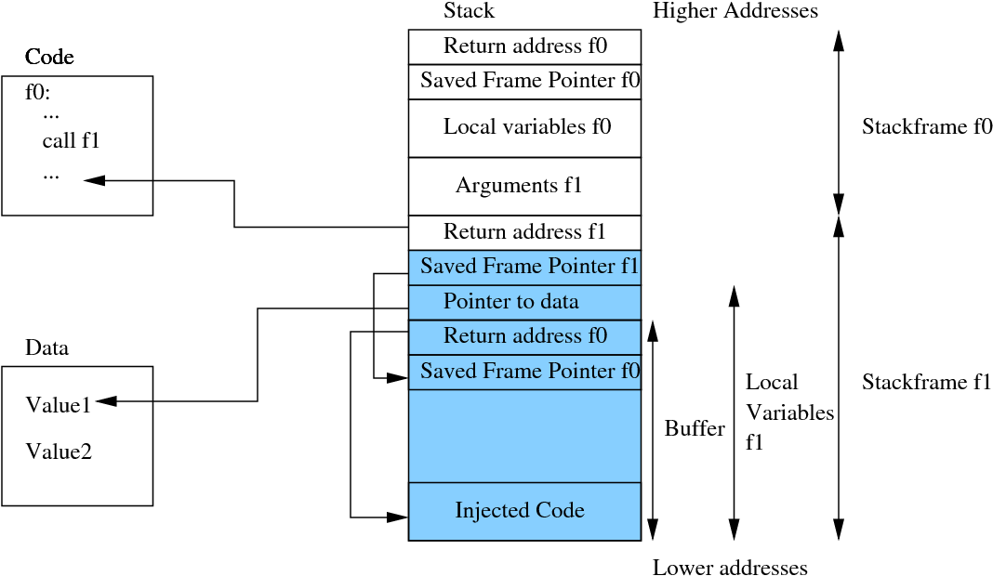
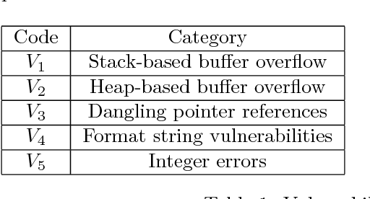
Becoming a Power Programmer (cont.2)
Avoiding Security Holes
Vulnerabilities exist because too few programmers understand the need to carefully restrict the quantity and forms of data they accept from untrusted sources. A first step in learning secure programming is to understand the consequences of the way data and control information are stored on the program stack.
Younan, Yves et al. “Code injection in C and C++: a survey of vulnerabilities and countermeasures.” (2004).
Notes:
Security:
Learning how data is stored on the program stack is a critical first step in avoiding vulnerabilities like code injection.
---
Figure short-form description:
Stack-Based Buffer Overflow (V1)
The second image illustrates how an attacker takes control of a program's execution.
Overwriting: An attacker sends too much data to a Buffer, spilling over into adjacent memory.
Corruption: This overflow overwrites the Return address, which normally tells the program where to go next.
Hijacking: The return address is changed to point to Injected Code provided by the attacker, allowing them to execute malicious commands.
Figure long-form description:
Anatomy of a Stack-Based Buffer Overflow (V1)
The second image illustrates how an attacker exploits a stack-based buffer overflow to redirect program execution.
Memory Layout and Execution Flow
Stack Frames: The memory is divided into frames, such as Stackframe f0 and Stackframe f1.
Return Addresses: Each frame contains a Return address (e.g., Return address f1) which tells the CPU where to resume execution after a function finishes.
The Buffer: Within the local variables of a function (like f1), a Buffer space is allocated.
The Attack Mechanism
Injected Code: An attacker provides input that exceeds the allocated size of the Buffer.
Overwriting Data: The overflow allows the attacker to write Injected Code into the memory and overwrite critical control data.
Redirecting Execution: In this example, the attacker has overwritten the Return address f0 and Saved Frame Pointer f0.
Control Hijack: The overwritten return address is modified to point back to the Injected Code at a lower memory address, causing the program to execute the attacker's malicious instructions instead of returning to the original code.

Slide 21
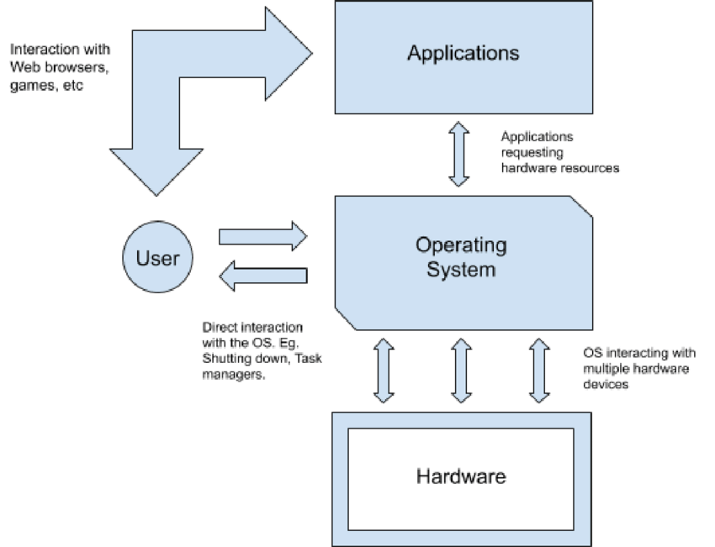
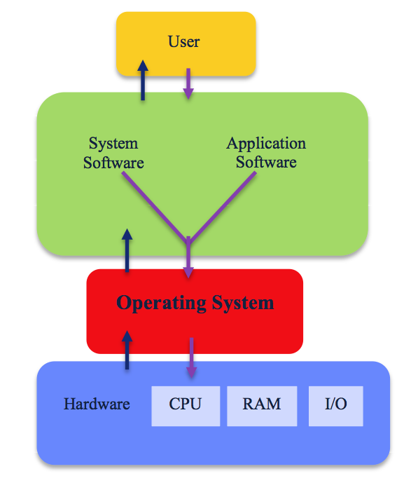
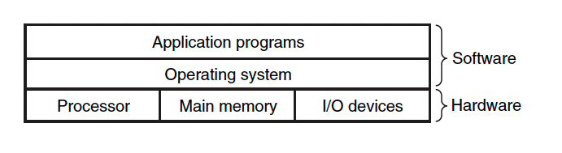
Operating System
Operating system can be thought of as a layer of software interposed between the application program and the hardware.
The operating system has two primary purposes:
(1) to protect the hardware from misuse by runaway applications, and
(2) to provide applications with simple and uniform mechanisms for manipulating complicated and often wildly different low-level hardware devices.
Shinde, Sakshat. (2020). Piecing together a basic Operating System. 10.13140/RG.2.2.18061.36326.
Image credit - https://www.uow.edu.au/
Image credit - Computer Systems, Bryant, O’Hallaron
Notes:
Operating System Role:
Acts as a layer between applications and hardware to protect hardware from misuse and provide uniform mechanisms for hardware manipulation.

Slide 22
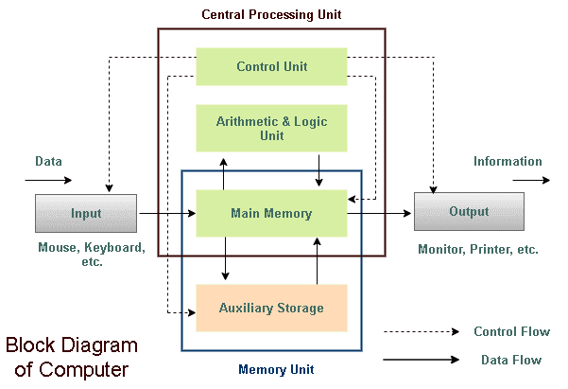
Hardware - CPU
Central Processing Unit (CPU)
Image credit - https://www.tutorialsmate.com/
Notes:
Block Diagram of a Computer Architecture
A high-level functional block diagram of a computer system.
It depicts the Central Processing Unit (CPU) containing a Control Unit and an Arithmetic & Logic Unit (ALU).
The CPU interacts with the Memory Unit, which consists of Main Memory and Auxiliary Storage.
Solid arrows represent Data Flow entering from Input (e.g., keyboard) and exiting to Output (e.g., monitor),
while dashed arrows indicate the Control Flow managed by the Control Unit.

Slide 23
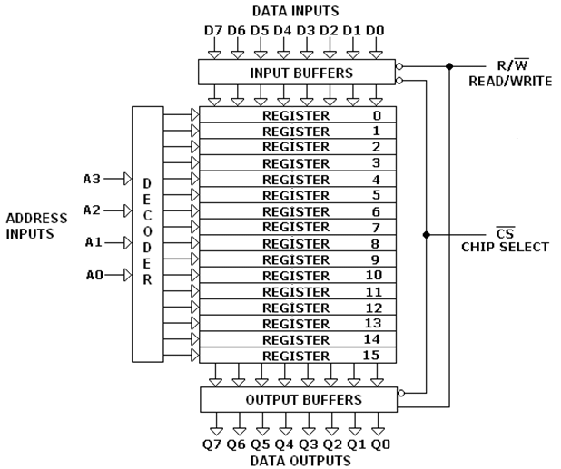
Hardware - RAM
Random Access Memory (RAM)
Buffer overflow vulnerabilities
Stack discipline
Image credit - Uzam, Murat. (2015). DIGITAL DESIGN LABORATORY MANUAL.
Notes:
Register File and Decoder Architecture
A digital logic diagram illustrating a memory or register file structure.
It shows a Decoder on the left taking four Address Inputs (A0-A3) to select one of 16 Registers (labeled 0 to 15).
The system includes Input Buffers for data entry (D0-D7) and Output Buffers for data retrieval (Q0-Q7),
controlled by Read/Write (R/W) and Chip Select (CS) signals.
Keep in mind that registers, cache, and main memory are all random-access memory.

Slide 24
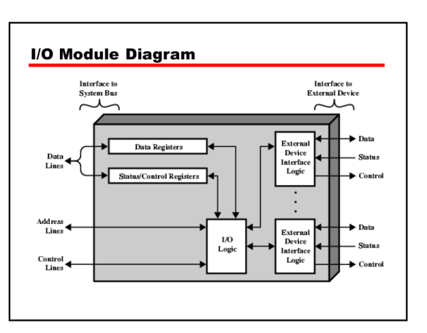
Hardware - I/O
Input/Output (I/O) Module
Buffer overflow vulnerabilities
Stack discipline
Notes:
I/O Module Diagram
A technical block diagram showing the internal structure of an I/O Module.
It features an Interface to System Bus on the left with data, address, and control lines
connected to internal Data Registers, Status/Control Registers, and I/O Logic.
The right side shows the Interface to External Device,
where multiple External Device Interface Logic blocks communicate with peripherals via data, status, and control signals.

Slide 25
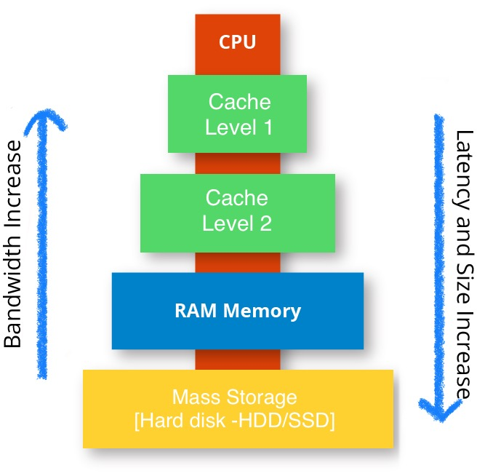
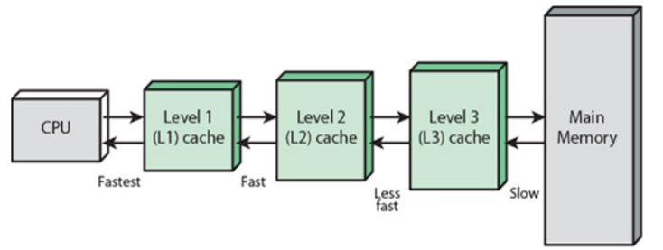
Cache Memory and Efficiency
Larger storage devices are slower than smaller storage devices.
And faster devices are more expensive to build than their slower
counterparts.
For example, the disk drive on a typical system might be 1000 times larger than the main memory, but it might take the processor 10,000,000 times longer to read a word from disk than from memory.
It is easier and cheaper to make processors run faster than it is to make main memory run faster. Therefore, processor-memory gap continues to increase.
To deal with the processor-memory gap, system designers include smaller faster storage devices called cache memories (or simply caches) that serve as temporary staging areas for information that the processor is likely to need in the near future.
The L1 and L2 caches are implemented with a hardware technology known as static random-access memory (SRAM).
Image credit - https://www.techcrypts.com/
Image credit - https://www.includehelp.com/
Notes:
Memory Caching
The Gap: Processors run much faster than main memory, creating a performance gap.
Caches: Small, fast SRAM-based "caches" (L1, L2, L3) store data the processor will likely need soon.

Slide 26
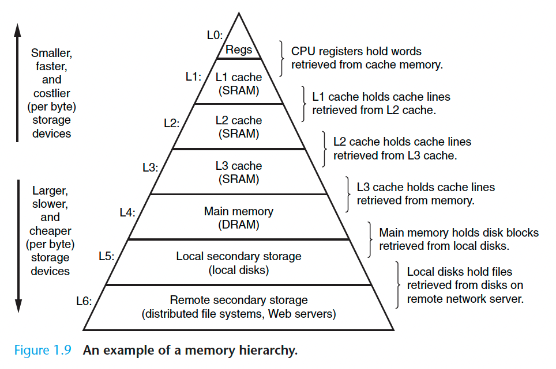
Memory Hierarchy
As we move from the top of the hierarchy to the bottom, the devices become slower, larger, and less costly per byte.
The register file occupies the top level in the hierarchy, which is known
as level 0, or L0. We show three levels of caching L1 to L3, occupying memory hierarchy levels 1 to 3.
Main memory occupies level 4, and so on.
The main idea of a memory hierarchy is that storage at one level serves as a cache for storage at the next lower level. Thus, the register file is a cache for the L1 cache.
Caches L1 and L2 are caches for L2 and L3, respectively. The L3 cache is a cache for the main memory, which is a cache for the disk.
On some networked systems with distributed file systems, the local disk serves as a cache for data stored on the disks of other systems.
Image credit - Computer Systems, Bryant, O’Hallaron
Notes:
Hierarchy:
Devices at the top (registers) are fastest and most expensive; devices at the bottom (disk) are slowest and cheapest. Each level serves as a cache for the level below it.

Slide 27
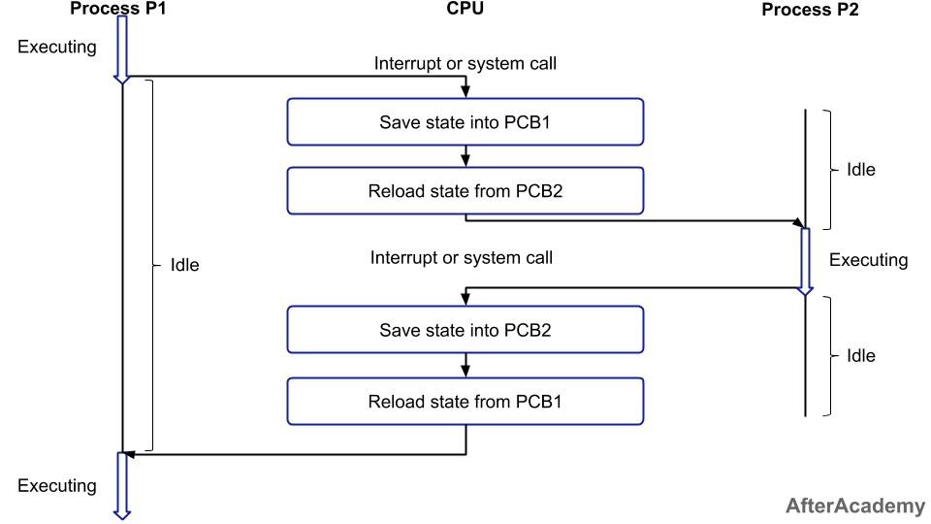
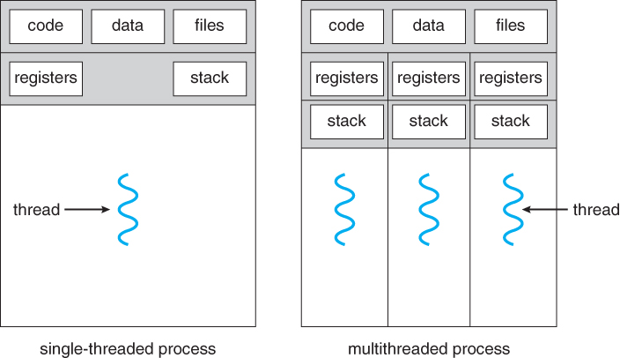
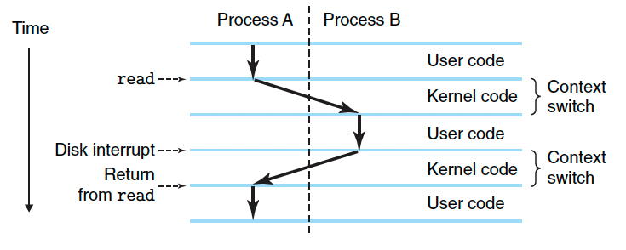
Concurrent Processes and Threads
A process is the operating system’s abstraction for a running program. Multiple processes can run concurrently on the same system, and each process appears to have exclusive use of the hardware.
A process can actually consist of multiple execution units, called threads, each running in the context of the process and sharing the same code and global data. Multi-threading is also one way to make programs run faster when multiple processors are available.
Image credit - https://afteracademy.com/
Image credit - https://www.cs.uic.edu/
Image credit - Computer Systems, Bryant, O’Hallaron
Notes:
Concurrency
Processes: An abstraction for a running program; multiple processes can run concurrently, appearing to have exclusive hardware use.
Threads: Execution units within a process that share the same code and global data, allowing for faster execution on multi-processor systems.

